Slide 1




"A Randomized Clinical Trial on Multimodal Prehabilitation in Colorectal Cancer Patients to Improve Functional Capacity and Lower Postoperative Complications: Preliminary Results."
Authors: Antonio Pesce MD PhD FACS, Nicolò Fabbri, Simona Colombari, Francesco Virgilio, Lisa Uccellatori, Giovanni Grazzi, Rosario Lordi, Gabriele Anania, and Carlo Vittorio Feo.
Azienda Unità Sanitaria Locale di Ferrara
DEPARTMENT OF SURGERY

Slide 2
I have no conflicts of interest or financial ties to disclose.
Azienda Unità Sanitaria Locale di Ferrara
DEPARTMENT OF SURGERY

Slide 3
Introduction
Postoperative complications occur in up to 50% of patients undergoing cancer colorectal resection and are associated with poor prognosis, increased costs, and lower health-related quality of life;
Even with no complications, major surgery is associated with 20 to 40% reduction in physiological and functional capacity and higher level of fatigue 6 to 8 weeks after surgery;
Many negative effects of major surgery can be reduced attenuating the surgical stress response by Enhanced Recovery After Surgery (ERAS) programs, to facilitate return of functional activities and accelerate convalescence.

Slide 4

Aims
Hypothesis – Implementation of a trimodal prehabilitation program (physical exercise, psychological support, and nutritional optimization) in patients undergoing ERAS colorectal resection for cancer with standard rehabilitation may determine:
  1) Better physical performance at 8 weeks after surgery,
  2) Decrease in postoperative complications and lenght of stay, and
  3) Reduced direct and indirect costs;
Primary aim – To compare the postoperative functional capacity in two groups of colorectal cancer patients undergoing colorectal resection following an ERAS program, one treated with trimodal prehabilitation before surgery followed by standard rehabilitation (experimental group) and the other undergoing standard rehabilitation alone after surgery (control group);
Secondary outcome – To evaluate postoperative complications and length of hospital stay.
Research funded by
(RF-2018-12367272)

Slide 5
Study design, setting, participants 1/2
Single centre, single-blind, randomized controlled trial;
Patients of age >18 years undergoing elective colorectal resection for cancer were eligible;
Exclusion criteria – Metastatic disease, severe walking impairments, renal failure stage >2, ASA score >3, preoperative chemo-radiation therapy;
Patients have been randomized either to prehabilitation intervention group, receiving 4-week prehabilitation or to control group receiving no prehabilitation. Both groups received rehabilitation following current international ERAS guidelines.

Slide 6
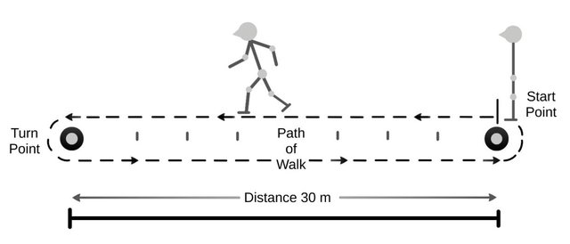

Study design, setting, participants 2/2
The primary outcome for functional capacity was measured by the 6-Minutes Walking Test (6MWT);
Secondary criteria for primary outcome were: a) cardiopulmonary exercise testing (CPET), b) handgrip strength, c) sit-to-stand, d) body composition and nutritional status, e) depression/anxiety, f) HRQoL.

Slide 7
Prehabilitation
(4 weeks) 3 training sessions per week
T-4 (baseline)
T-1
T 0
T+4
T+8
CPET
6MWT
30’’ STS
1RM
HANDGRIP
CPET
6MWT
30’’ STS
1RM
HANDGRIP
SURGERY
CPET
6MWT
30’’ STS
1RM
HANDGRIP
CPET
6MWT
30’’ STS
1RM
HANDGRIP
Notes:
All measures have been recorded in both study groups at baseline (beginning of prehabilitation period) and prior to surgery (end of prehabilitation period) to measure the effects of intervention, and at 4 and 8 weeks after surgery to assess the impact of the intervention throughout the perioperative period.

Slide 8
Results: baseline characteristics
Variables | Prehabilitation Group (N=35) | Control Group (N=36) | P Value
Gender [N (%)] Male Female | 21 (58.3) 14 (41.7) | 21 (60.0) 15 (40.0) | 0.886
Age (years) ±SD | 68 ±8.7 | 70 ±9.6 | 0.329
BMI (Kg/m²) ±SD | 27.9 ±5.5 | 27.8 ±4.8 | 0.903
ASA score [N (%)] 1 2 3 | 0 16 (47.7) 19 (54.3) | 0 21 (58.3) 15 (41.7) | 0.287
CCI ±SD | 4.68 ±1.8 | 4.86 ±1.2 | 0.635
Coronary disease [N (%)] No Yes | 30 (85.7) 5 (14.3) | 34 (94.4) 2 (5.6) | 0.217
Heart failure [N (%)] No Yes | 35 (100) 0 | 36 (100) 0
Peripheral vascular disease [N (%)] No Yes | 31 (88.57) 4 (11.43) | 33 (91.6) 3 (8.4) | 0.662
COPD [N (%)] No Yes | 34 (97.14) 1 (2.86) | 36 (100) 0 | 0.307
Diabetes mellitus [N (%)] No Yes | 29 (82.8) 6 (17.2) | 33 (91.6) 3 (8.34) | 0.265
Kidney failure [N (%)] No Yes | 34 (97.1) 1 (2.9) | 35 (97.2) 1 (2.8) | 0.368
PG-SGA score [N (%)] 4 week | A 22 (66.6) B 11 (33.4) | A 27 (75) B 9 (25) | 0.446
PG-SGA score [N (%)] 1 week | A 12 (38.7) B 19 (61.3) | A 15 (48.3) B 16 (51.7) | 0.442
Preoperative hemoglobin (g/dl) ±SD | 13,07 ±1.7 | 13,53 ±1.9 | 0.308
Preoperative blood glucose level (mg/dl) ±SD | 106,34 ±16.5 | 104,47 ±16.6 | 0.635

Slide 9
Results: intra-operative variables
Variables | Prehabilitation Group (N=35) | Control Group (N=36) | P Value
Epidural catheter insertion [N (%)] Yes No | 5 (14.2) 30 (85.8) | 5 (13.8) 31 (86.2) | 0.962
Peripheral nerve block [N (%)] Yes No | 26 (74.2) 9 (25.8) | 23 (63.8) 13 (36.2) | 0.344
Intraoperative infusions (ml) ±SD | 208.8 ±40.6 | 221.2 ±57.2 | 0.298
PONV prophylaxis [N (%)] Yes No | 14 (40.0) 21 (60.0) | 20 (55.5) 16 (44.5) | 0.190
Type of Surgery [N (%)] Right colectomy (Extended right colectomy) Left colectomy (Extended left colectomy) Transverse colectomy Sigmoidectomy | 25 (71.5) 7 (20.0) 6 (15.7) 0 0 4 (12.8) | 21 (58.5) 4 (11.1) 5 (13.8) 0 0 10 (27.7) | 0.272
Surgical approach [N (%)] Laparoscopy Laparotomy Laparoscopy with conversion | 34 (97.2) 1 (2.8) 0 | 34 (94.5) 0 2 (5.5) | 0.225
Other procedure [N (%)] | 8 (22.8) | 4 (11.1) | 0.187
Duration of surgery (minutes) Mean ±SD | 208,85 ±40.62 | 221.25 ±57.25 | 0.298
Abdominal drain [N (%)] Yes No | 21 (60.0) 13 (40.0) | 19 (52.7) 16 (47.3) | 0.494
Postoperative transfusion [N (%)] Yes No | 2 (5.7) 33 (94.3) | 1 (2.7) 35 (97.3) | 0.539
ICU admission [N (%)] Yes No | 3 (8.6) 32 (91.4) | 1 (2.8) 35 (97.2) | 0.290
ICU lenght of stay (day) ±SD | 0.4 ±2.04 | 0.02 ± 0.16 | 0.246

Slide 10
Physical performances after 4 weeks of prehabilitation before surgery
Variables | Prehabilitation group (N=35) | Control Group (N=36) | P Value
6MWD (meters) | 523 ± 24.6 | 427 ± 25.3 | 0.01
VO2 peak (ml/kg/min) | 20.4 (14-32.3) | 16.9 (10-33) | 0.03
Hand grip test (kg) | 37 ± 16 | 35 ± 11 | 0.6
Sit-to-stand test | 12.5 (8-31) | 12 (8-31) | 0.8

Slide 11
Physical performances after surgery
Variables | Prehabilitation group (N=35) | Control Group (N=36) | P Value
6MWD (m) | 514 ± 89 | 411 ± 115 | 0.003
VO2 peak (ml/kg/min) | 22 ± 5 | 20 ± 6 | 0.38
Hand grip test (kg) | 33 ± 11 | 32 ± 10 | 0.8
Sit-to-stand test | 15.5 (8-29) | 12 (8-29) | 0.08
At 4 weeks after surgery
Variables | Prehabilitation group (N=35) | Control Group (N=36) | P Value
6MWD (m) | 531 ± 82 | 441 ± 107 | 0.008
VO2 peak (ml/kg/min) | 21 ± 4 | 20 ± 5 | 0.4
Hand grip test (kg) | 34 ± 12 | 33 ± 9 | 0.8
Sit-to-stand test | 18 (12-33) | 13 (9-30) | 0.01
At 8 weeks after surgery

Slide 12
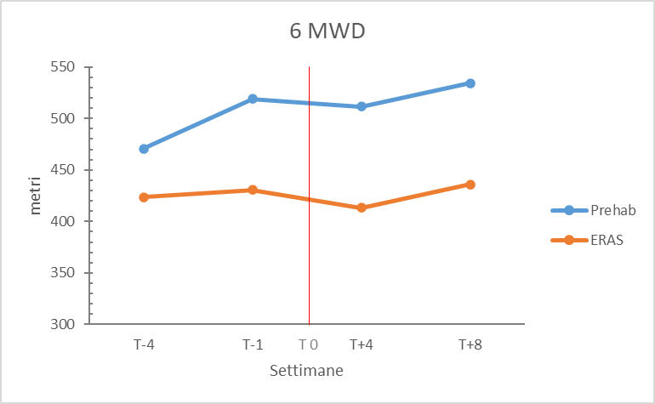
Physical performance at different times between the two groups

Slide 13
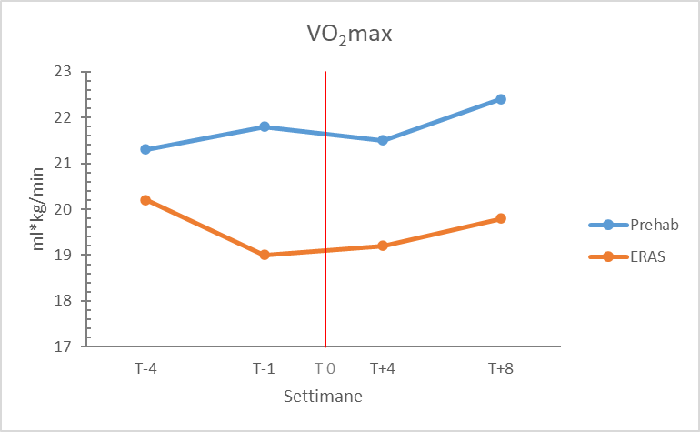
Physical performance at different times between the two groups

Slide 14
Results: post-operative variables
Variables | Prehabilitation Group (N=35) | Control Group (N=36) | P Value
Oral liquid intake (day) Mean± SD | 1.66 ±2.05 | 1.32 ±0.63 | 0.356
Solid oral intake (day) Mean± SD | 2.14±2.2 | 1.94±0.91 | 0.627
Time to passage of gas (day) Mean±SD | 2.08 ±0.91 | 1.8 ±0.83 | 0.177
Time to passage of stool (day) Mean± SD | 2.94 ±1.18 | 2.97 ±1.09 | 0.917
Time to optimal pain control (NRS<4) (day) Mean±SD | 2.8 ±1.65 | 2.54 ±1.29 | 0.471
Early mobilization (day) Mean ±SD | 2.74 ±3.22 | 2.2 ±0.90 | 0.340
Fit for discharge (day) Mean ±SD | 4.77 ±4.25 | 4.14 ±1.24 | 0.404
Discharge (day) Mean ±SD | 5.45 ±4.61 | 4.8 ±1.53 | 0.426
Clavien- Dindo complications [N (%)] Total 15/71 (21.1) Grade I Grade II Grade IIIa Grade IIIb Grade IV Grade V | 2 (5.7) 4 (11.4) 1 (2.8) 0 (0.0) 0 (0.0) 0 (0.0) | 5 (13.9) 2 (5.5) 1 (2.8) 0 (0.0) 0 (0.0) 1 (2,8) | 0.565
Reintervention [N (%)] | 1 (2.8 ) | 2 (5.5) | 0.572
30-day hospital re-admission [N (%)] | 0 (0.0) | 1 (2.8) | 0.321
30-day mortality [N (%)] | 0 (0.0) | 1 (2.8) | 0.321
TNM staging [N (%)] 0 I II III IV | 7 (20.0) 11 (31.4) 8 (22.8) 9 (25.7) 0 (0.0) | 4 (11.1) 11 (30.5) 13 (36.1) 8 (22.2) 0 (0.0) | 0.561

Slide 15
Discussion
The preliminary results showed a greater improvement of functional physical performances in prehabilitation group vs control group;
There was no difference in postoperative complications and hospital lenght of stay between the two groups, both treated by minimally invasive surgical technique and following ERAS perioperative care principles;
However, this study was not powered to determine the impact of prehabilitation on postoperative outcomes;
Finally, the analysis of indirect healthcare costs is still ongoing.

Slide 16
Conclusion
The prehabilitation protocol has proven to be feasible and safe and the proposed training was effective in improving exercise functional capacity in surgical patients, due to multidisciplinary involvement;
However, given that these findings are preliminary and considering various external influencing factors, it is not yet determinable whether the proposed intervention can effectively reduce postoperative complications and hospital stay duration.

